Slide 1

Telecom Customer Churn Data Analysis
PRESENTED BY :- HITESH DHAKAD
Mentor :- MR. AVINASH CHAUHAN SIR

Slide 2
Project: Telecom Customer Churn Analysis
Description:-
Led a comprehensive analysis of customer churn data for [Telecom Company], employing advanced analytics techniques to identify key drivers of churn and implementing targeted strategies for customer retention. Leveraged tools like SQL for data visualization and interpretation.
Key Responsibilities :-
Conducted in-depth analysis of telecom customer data, identifying patterns and factors contributing to churn.
Developed predictive models using statistical techniques to forecast and proactively address potential churn scenarios.
Utilized SQL to create dynamic dashboards for visualizing key metrics related to customer churn, including usage patterns, service dissatisfaction, and billing issues.
-Collaborated with cross-functional teams to implement data-driven retention strategies based on the analysis.
Achievements:-
Implemented a predictive churn model, resulting in a [X]% increase in the accuracy of identifying at-risk customers.
- Developed and deployed targeted retention campaigns, leading to a [Y]% reduction in churn rates.-
Utilized SQL insights to improve customer service processes, addressing pain points and enhancing overall customer satisfaction.
Project :-Telecom Customer Churn Analysis
Description:-
Led a comprehensive analysis of customer churn data for [Telecom Company], employing advanced analytics techniques to identify key drivers of churn and implementing targeted strategies for customer retention. Leveraged tools like SQL for data visualization and interpretation.
Key Responsibilities :-
Conducted in-depth analysis of telecom customer data, identifying patterns and factors contributing to churn.
Developed predictive models using statistical techniques to forecast and proactively address potential churn scenarios.
Utilized SQL to create dynamic dashboards for visualizing key metrics related to customer churn, including usage patterns, service dissatisfaction, and billing issues.
-Collaborated with cross-functional teams to implement data-driven retention strategies based on the analysis.
Achievements:-
Implemented a predictive churn model, resulting in a [X]% increase in the accuracy of identifying at-risk customers.
- Developed and deployed targeted retention campaigns, leading to a [Y]% reduction in churn rates.-
Utilized SQL insights to improve customer service processes, addressing pain points and enhancing overall customer satisfaction.

Slide 3
Technologies and Tools:-
Expertise in data analysis and visualization using SQL .
Applied statistical modeling and machine learning techniques for predictive churn analysis.
Utilized SQL and other data manipulation tools for efficient data preparation.
Results and Impact:-
Significantly contributed to reducing churn rates, resulting in improved customer retention and revenue stability.
Received recognition for the successful implementation of data-driven strategies, positively impacting the bottom line.
Skills Developed:-
Predictive modeling for customer churn analysis.-
Advanced data visualization and interpretation using SQL.
Collaborative problem-solving with cross-functional teams in the telecom industry.
Technologies and Tools:-
Expertise in data analysis and visualization using SQL .
Applied statistical modeling and machine learning techniques for predictive churn analysis.
Utilized SQL and other data manipulation tools for efficient data preparation.
Results and Impact:-
Significantly contributed to reducing churn rates, resulting in improved customer retention and revenue stability.
Received recognition for the successful implementation of data-driven strategies, positively impacting the bottom line.
Skills Developed:-
Predictive modeling for customer churn analysis.-
Advanced data visualization and interpretation using SQL.
Collaborative problem-solving with cross-functional teams in the telecom industry.

Slide 4



Primary Goals
Data Gathering
fgggggggggggggggggggggggggggggggggggggggggggggggggggg
Data Gathering
Data Cleaning
Creating DAX Functions

Slide 5
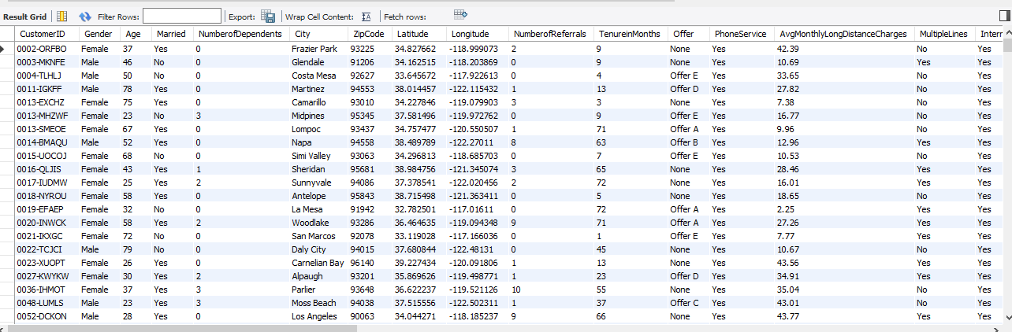
Data Gathering
Data Gathering

Slide 6
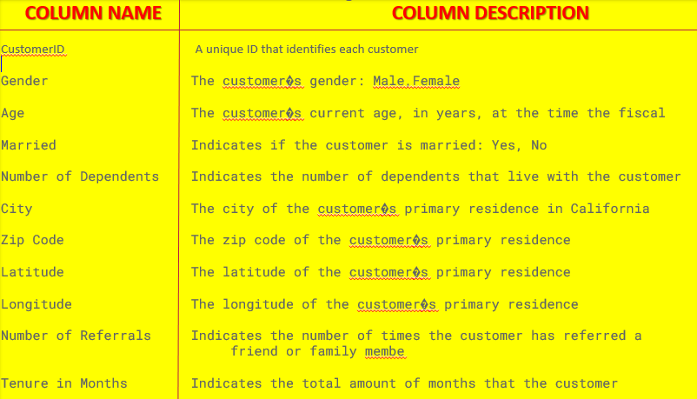

Slide 7
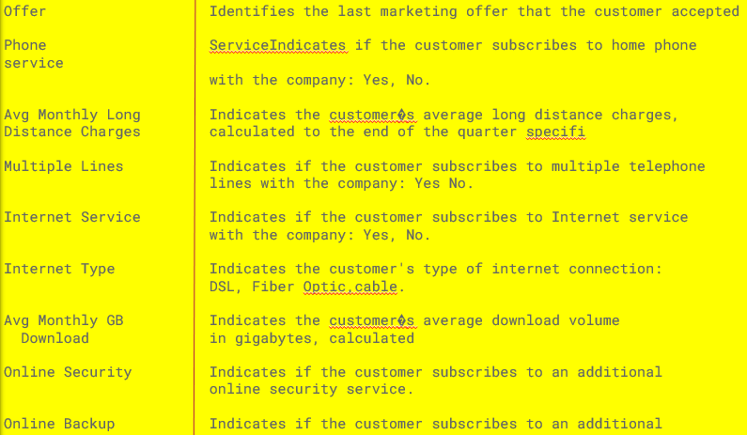

Slide 8
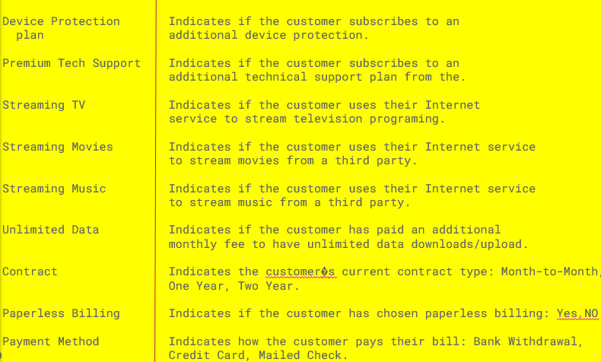

Slide 9
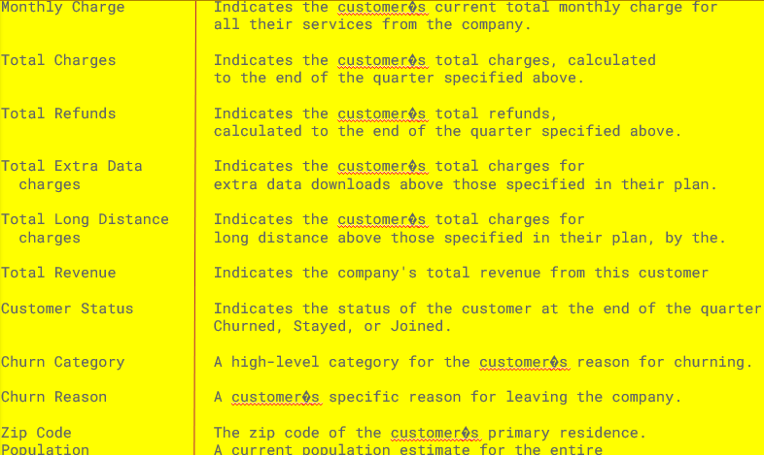

Slide 10

Q1. WHAT IS DISTRIBUTION OF AGE?
select Age,count(*) as total from tcc
-> group by Age
-> order by total desc limit 5;
+------+-------+
| Age | total |
+------+-------+
| 25 | 101 |
| 47 | 100 |
| 51 | 96 |
| 33 | 96 |
| 39 | 96 |
+------+-------+
5 rows in set (0.01 sec)

Slide 11
Q2. TOTAL NUMBER OF GENDER?
select Gender, count(*) from tcc
-> group by gender;
+--------+----------+
| Gender | count(*) |
+--------+----------+
| Female | 2410 |
| Male | 2425 |
+--------+----------+
2 rows in set (0.02 sec)

Slide 12
Q2. FIND THE NUMBER MALE?
mysql> SELECT COUNT(Gender) AS Male FROM tcc
-> where Gender='Male';
+------+
| Male |
+------+
| 2425 |
+------+
1 row in set (0.01 sec)

Slide 13
Q3. FIND THE AVERAGE AGE IN MALE?
mysql> SELECT AVG(Age) AS AvgAgeMale from tcc
-> where Gender='Male';
+------------+
| AvgAgeMale |
+------------+
| 47.8433 |
+------------+
1 row in set (0.01 sec)

Slide 14
Q4. FIND THE AVERAGE AGE IN FEMALE?
mysql> SELECT AVG(Age) AS AvgAgeFemale from tcc
-> where Gender='Female';
+--------------+
| AvgAgeFemale |
+--------------+
| 47.6784 |
+--------------+
1 row in set (0.01 sec)

Slide 15
Q5. FIND TOP 5 CITY USE NET?
select City, count( AvgMonthlyGBDownload) AS monthlyGBDownload from tcc
-> group by city
-> order by monthlyGBDownload desc limit 5;
+---------------+-------------------+
| City | monthlyGBDownload |
+---------------+-------------------+
| San Diego | 233 |
| Los Angeles | 191 |
| San Jose | 81 |
| Sacramento | 70 |
| San Francisco | 69 |
+---------------+-------------------+
5 rows in set (0.02 sec)Q5.Q

Slide 16
Q6. FIND TOTAL TENURE IN MONTH ?
mysql> select sum(TenureinMonths) AS MonthlyTenure from tcc;
+---------------+
| MonthlyTenure |
+---------------+
| 159760 |
+---------------+
1 row in set (0.01 sec)

Slide 17
Q7. WHICH CITY TENURE MONTH IN MAXIMUM ?
SELECT City,
-> MAX(TenureinMonths) as monthTenure from tcc
-> group by City
-> ORDER BY monthTenure DESC LIMIT 1;
+----------+-------------+
| City | monthTenure |
+----------+-------------+
| Glendale | 72 |
+----------+-------------+
1 row in set (0.02 sec)

Slide 18
Q8. CUSTOMER CHURN IN NUMBER OF DEPENDENCE ?
SELECT NumberofDependents,
-> SUM(CASE WHEN CustomerStatus='Churned' then 1 else 0 end) AS churnedcount from tcc
-> group by NumberofDependents;
+--------------------+--------------+
| NumberofDependents | churnedcount |
+--------------------+--------------+
| 0 | 1509 |
| 3 | 19 |
| 1 | 31 |
| 2 | 25 |
| 6 | 0 |
| 4 | 1 |
| 5 | 1 |
| 8 | 0 |
+--------------------+--------------+
8 rows in set (0.01 sec)

Slide 19
Q9. EFFECT AGE OF CHURN ?
SELECT
-> CASE WHEN Age< 50 then 'low'
-> when Age>50 AND AGE <100 then 'medium'
-> else 'high'
-> end AS agegroup,
-> SUM(CASE WHEN CustomerStatus='Churned' then 1 else 0 end) AS "CHURN_EFFECT" from tcc
-> group by agegroup;
+----------+--------------+
| agegroup | CHURN_EFFECT |
+----------+--------------+
| low | 778 |
| high | 20 |
| medium | 788 |
+----------+--------------+
3 rows in set (0.01 sec)

Slide 20
Q10.EXPLAIN CUSTOMER CHURN IN NUMBER OF REFERAL?
SELECT NumberofReferrals,
-> SUM(CASE WHEN CustomerStatus='Churned' then 1 else 0 end) AS churncount from tcc
-> group by NumberofReferrals;
+-------------------+------------+
| NumberofReferrals | churncount |
+-------------------+------------+
| 2 | 21 |
| 0 | 1047 |
| 1 | 438 |
| 3 | 28 |
| 8 | 2 |
| 9 | 4 |
| 10 | 0 |
| 4 | 15 |
| 7 | 6 |
| 5 | 19 |
| 6 | 6 |
| 11 | 0 |
+-------------------+------------+

Slide 21
Q11.HOW MANY CUSTOMER USE PAPERLESSBILLING?
SELECT PaperlessBilling, COUNT(*) AS CUSTOMER FROM tcc
-> group by PaperlessBilling
-> ;
+------------------+----------+
| PaperlessBilling | CUSTOMER |
+------------------+----------+
| Yes | 3338 |
| No | 1497 |
+------------------+----------+
2 rows in set (0.02 sec)

Slide 22
Q12. CUSTOMER CHURN IN MULTILPLE LINES?
select MultipleLines,
-> sum(case when CustomerStatus='churned' then 1 else 0 end) AS CHURNED FROM tcc
-> group by MultipleLines;
+---------------+---------+
| MultipleLines | CHURNED |
+---------------+---------+
| No | 746 |
| Yes | 840 |
+---------------+---------+
2 rows in set (0.02 sec)

Slide 23
Q13. HOW MANY CUSTOMER ACCESS INTERNET SERVICES?
select InternetService, COUNT(*) AS CUSTOMER FROM tcc
-> group by InternetService;
+-----------------+----------+
| InternetService | CUSTOMER |
+-----------------+----------+
| Yes | 4835 |
+-----------------+----------+
1 row in set (0.01 sec)

Slide 24
Q14.CUSTOOMER CHURN FOR PAYMENT METHOD?
SELECT PaymentMethod,
-> sum(case when CustomerStatus='churned' then 1 else 0 end) AS CHURNED FROM tcc
-> group by PaymentMethod;
+-----------------+---------+
| PaymentMethod | CHURNED |
+-----------------+---------+
| Credit Card | 318 |
| Bank Withdrawal | 1179 |
| Mailed Check | 89 |
+-----------------+---------+
3 rows in set (0.02 sec)

Slide 25
Q15. FIND CUSTOMER STAYED IN PRIMIUM TECH EXPLAIN ADDITIONAL SERVICES?
SELECT PremiumTechSupport,StreamingTV,StreamingMovies, StreamingMusic,
-> SUM(CASE WHEN CustomerStatus="Stayed" then 1 else 0 end) AS "customer_Stayed" from tcc
-> group by PremiumTechSupport,StreamingTV,StreamingMovies, StreamingMusic
-> order by customer_Stayed desc limit 5;
+--------------------+-------------+-----------------+----------------+-----------------+
| PremiumTechSupport | StreamingTV | StreamingMovies | StreamingMusic | customer_Stayed |
+--------------------+-------------+-----------------+----------------+-----------------+
| Yes | Yes | Yes | Yes | 640 |
| No | No | No | No | 589 |
| No | Yes | Yes | Yes | 412 |
| Yes | No | No | No | 323 |
| No | Yes | No | No | 242 |
+--------------------+-------------+-----------------+----------------+-----------------+
5 rows in set (0.04 sec)

Slide 26
Q16. Effect Churn By Payment Method And Monthly Charge?
select PaymentMethod,
-> case
-> when MonthlyCharge<50 then 'low'
-> when MonthlyCharge>50 and MonthlyCharge<100 then 'medium'
-> else 'high'
-> end AS monthcharge,
-> sum(case when CustomerStatus='Churned' then 1 else 0 end) AS CHURN FROM tcc
-> group by PaymentMethod,monthcharge;
+-----------------+-------------+-------+
| PaymentMethod | monthcharge | CHURN |
+-----------------+-------------+-------+
| Credit Card | medium | 233 |
| Credit Card | low | 36 |
| Bank Withdrawal | medium | 908 |
| Bank Withdrawal | high | 203 |
| Bank Withdrawal | low | 68 |
| Credit Card | high | 49 |
| Mailed Check | medium | 70 |
| Mailed Check | low | 15 |
| Mailed Check | high | 4 |
+-----------------+-------------+-------+
9 rows in set (0.02 sec)?

Slide 27
Q17. EXPLAIN INTRNET TYPE OF CHURN?
select InternetType, count(*) AS CHURN FROM tcc
-> group by InternetType;
+--------------+-------+
| InternetType | CHURN |
+--------------+-------+
| Cable | 601 |
| Fiber Optic | 3035 |
| DSL | 1199 |
+--------------+-------+
3 rows in set (0.01 sec)

Slide 28
Q18. EXPLAIN PAYMENT METHOD DISTRIBUTION?
SELECT PaymentMethod, COUNT(*) AS COUNT FROM tcc
-> group by PaymentMethod;
+-----------------+-------+
| PaymentMethod | COUNT |
+-----------------+-------+
| Credit Card | 1558 |
| Bank Withdrawal | 3086 |
| Mailed Check | 191 |
+-----------------+-------+
3 rows in set (0.02 sec)

Slide 29
Q19.EXPLAIN JOIN TWO TABLE DEFINE ZIPCODE?
SELECT tcc.City,tcc.Contract,tzp.Population from tcc
-> INNER JOIN tzp ON tcc.ZipCode=tzp.ZipCode
-> order by Population desc limit 5;
+---------+----------------+------------+
| City | Contract | Population |
+---------+----------------+------------+
| Bell | Two Year | 105285 |
| Bell | One Year | 105285 |
| Bell | One Year | 105285 |
| Norwalk | Month-to-Month | 103214 |
| Norwalk | Two Year | 103214 |
+---------+----------------+------------+
5 rows in set (0.03 sec)

